Slide 1

What type of games should we produce next?

Slide 2
Audience
Product Development Team
Manager

Slide 3
Question
What type of game should we produce next?

Slide 4
Data
Top games from Google Play Store
Data Description
Data taken from Kaggle.
Data contains the names of the games along with installs and ratings and categories.
Data contains 1730 different game titles that were available on google playstore.

Slide 5
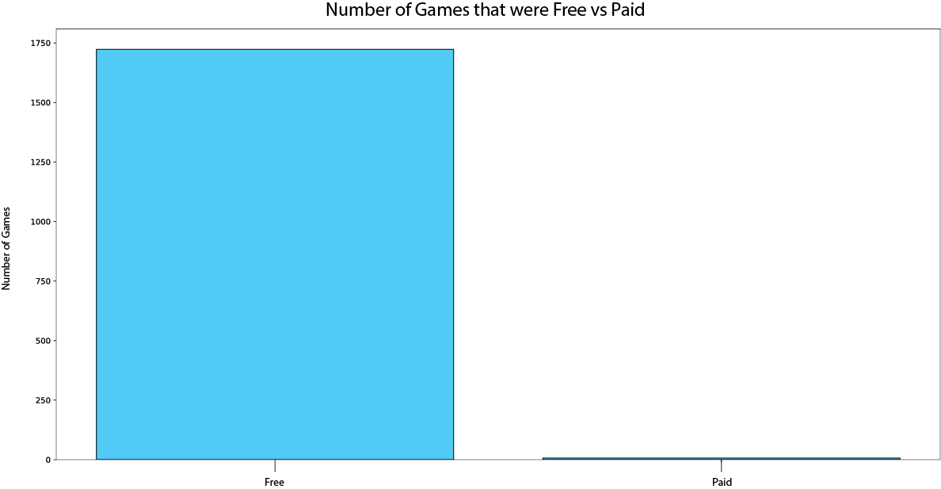
Paid Vs Free games

Slide 6
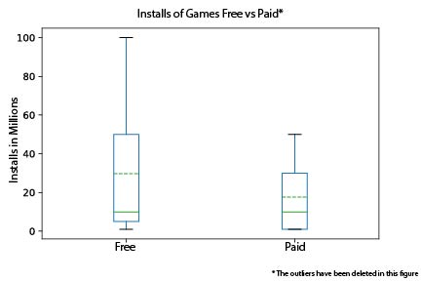
Paid Vs Free games

Slide 7
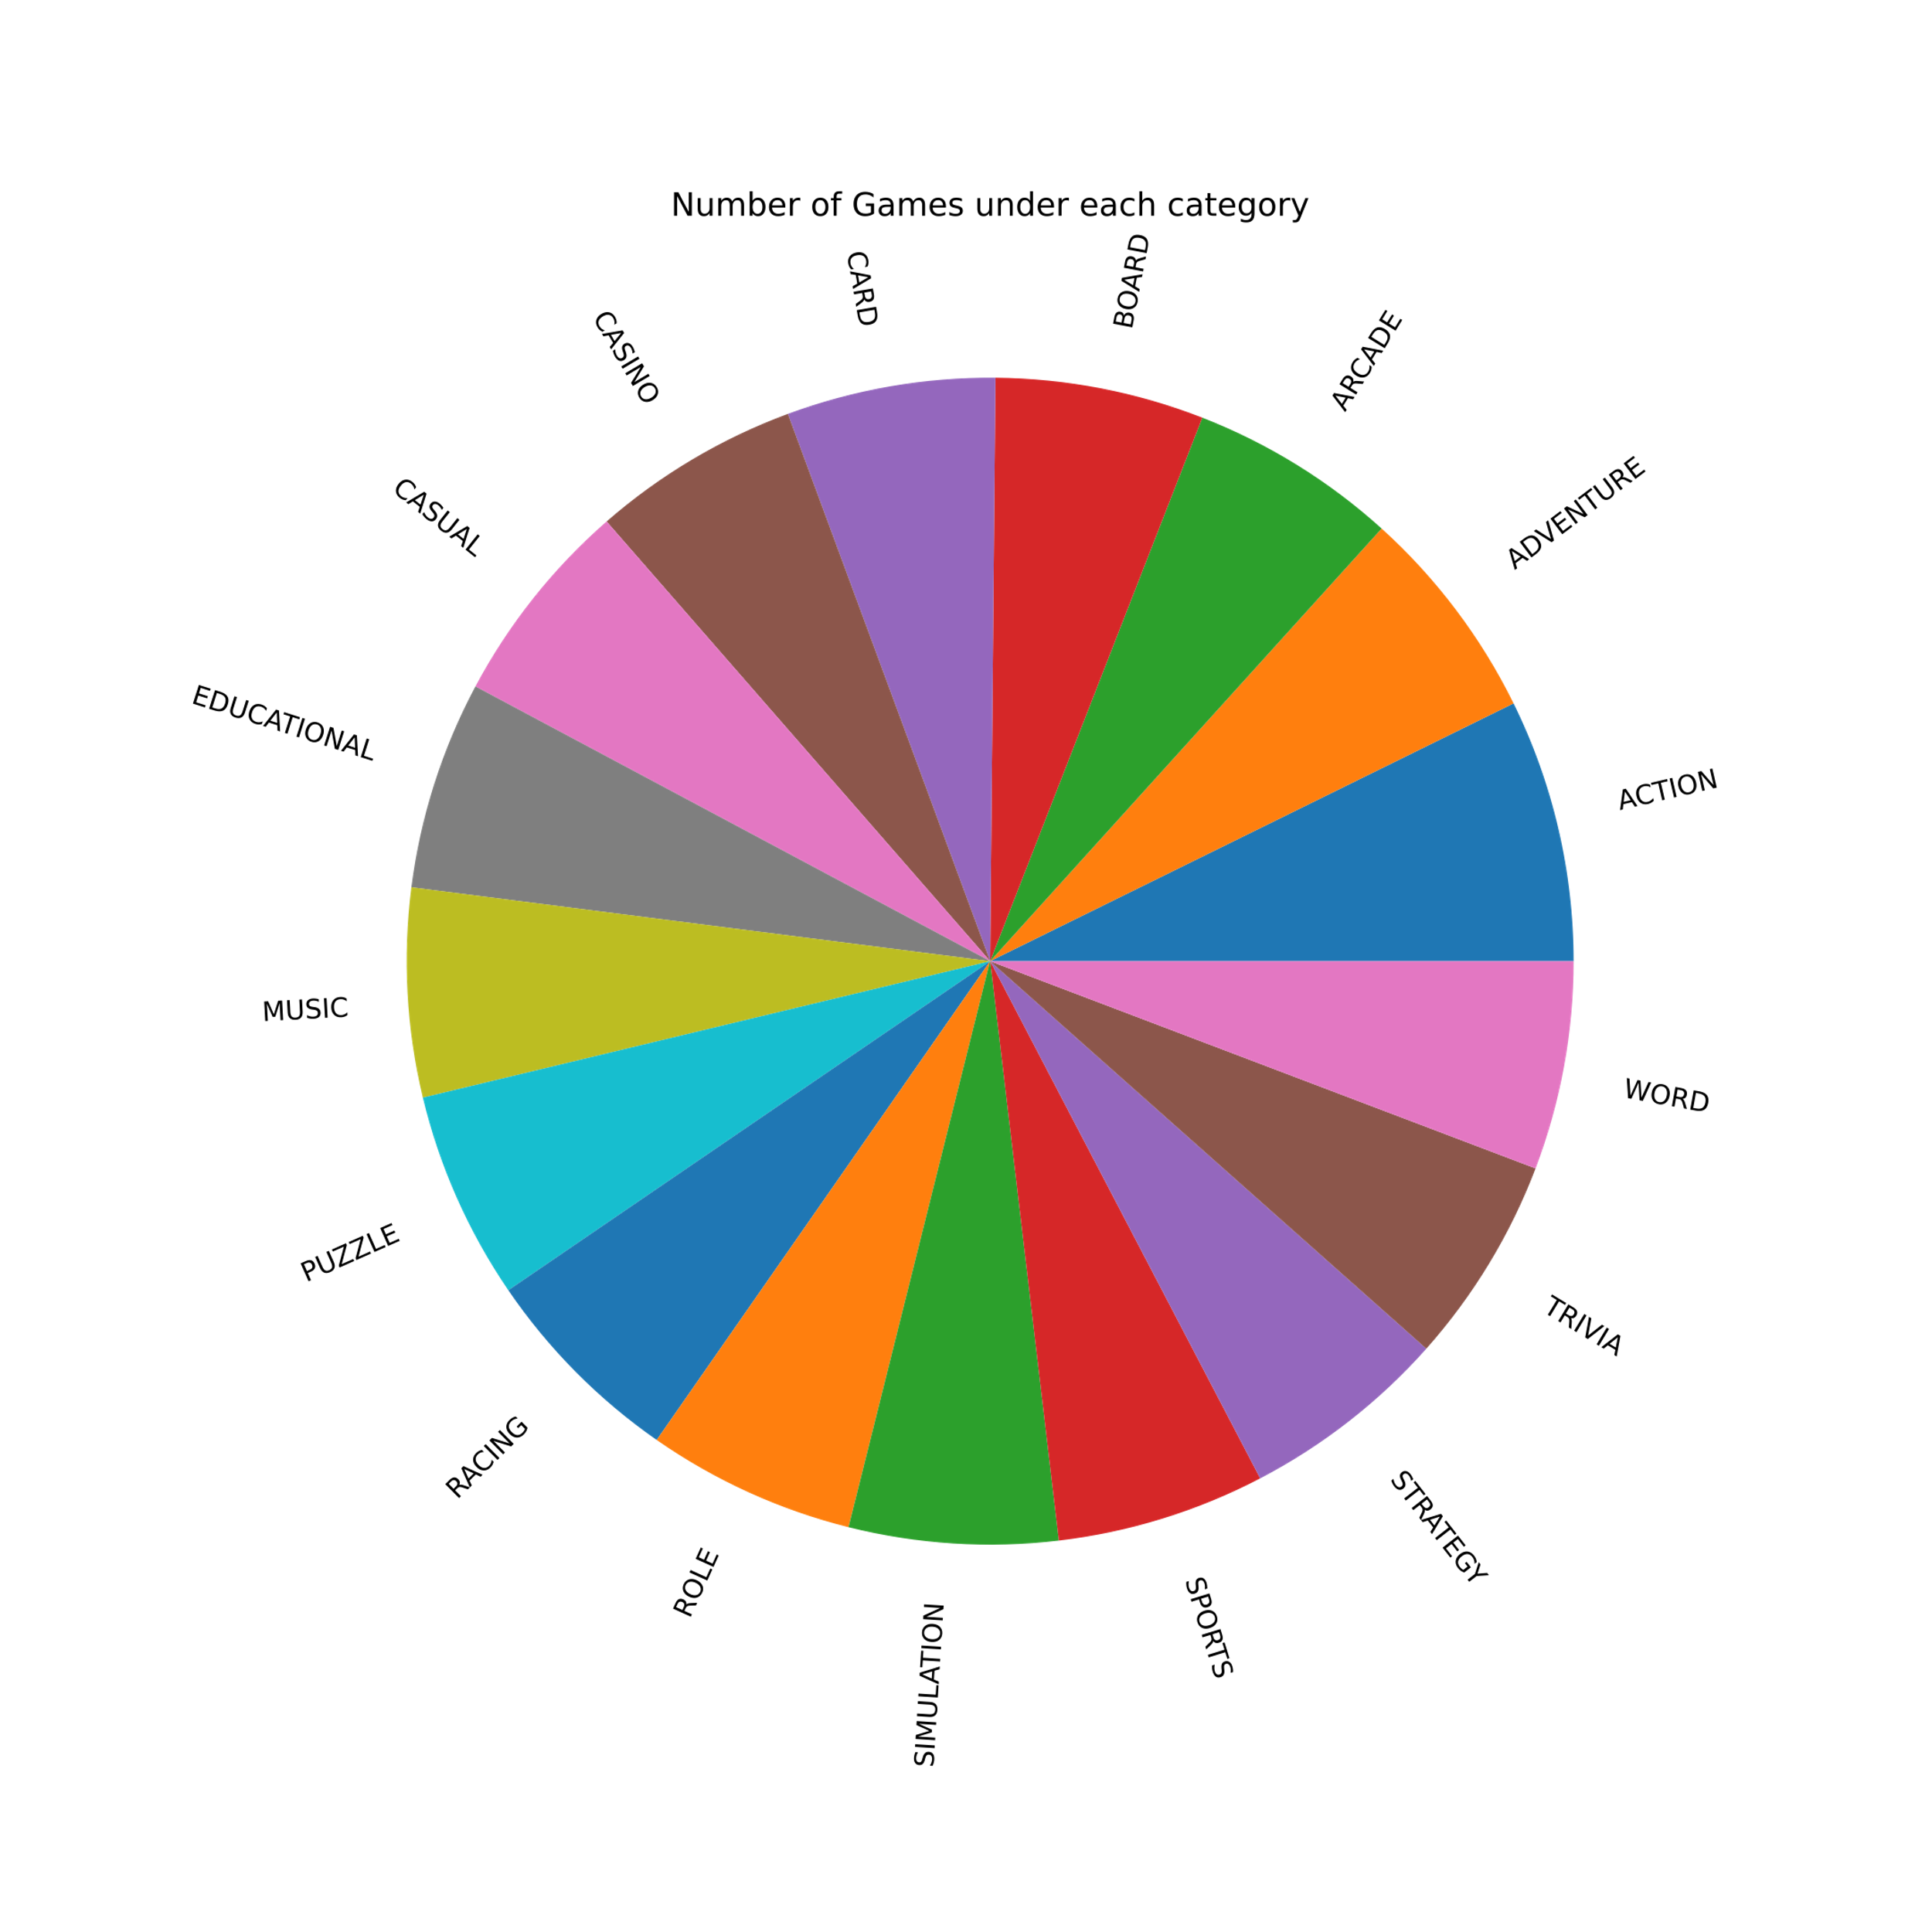
Categories
Notes:
As you can tell in the pie chart it looks like the categories are pretty evenly distributed unlike paid vs free types of games.
With that being said lets switch to a Histogram. You can quickly tell that card games and word games. Have slightly more games in those categories. But exploring which category is best would be better to explore and compare with.

Slide 8
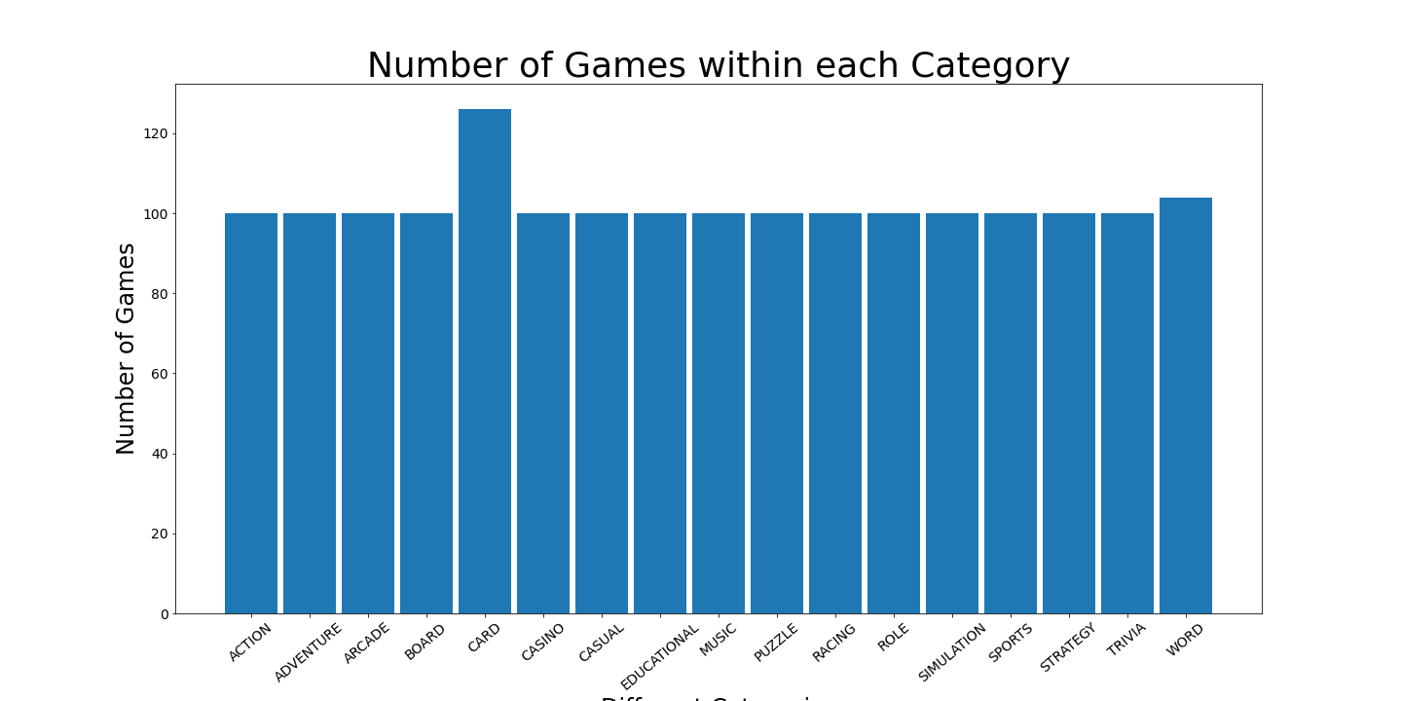
Categories
Notes:
As you can tell in the pie chart it looks like the categories are pretty evenly distributed unlike paid vs free types of games.
With that being said lets switch to a Histogram. You can quickly tell that card games and word games. Have slightly more games in those categories. But exploring which category is best would be better to explore and compare with.

Slide 9
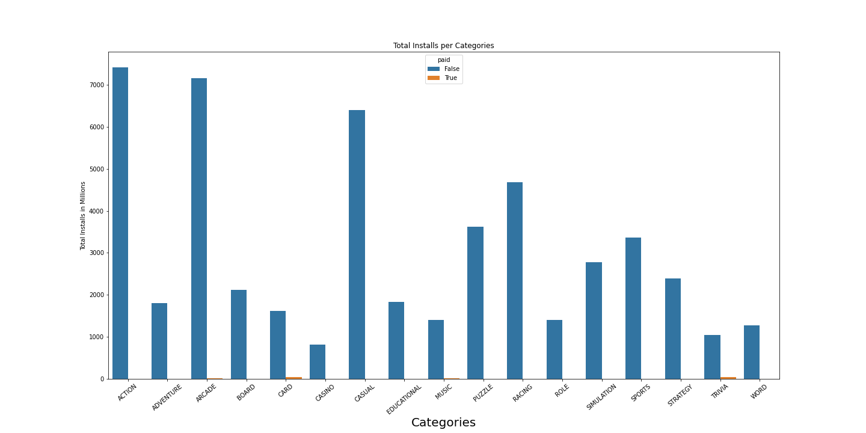

Total installs and categories
Notes:
You can see Action games were the highest installs. I did plot paid vs free in this graph as well. The paid games you can see that card games were installed the most but as you can recall in the slide earlier that cards had slightly more games in the list so this could be a contributing factor. Also there were only 7 games in this list that were paid games so it’s harder to draw a conclusion if this were true. A close second in installs would be Arcade games. The way I found this data is summed all the installs in each category.

Slide 10
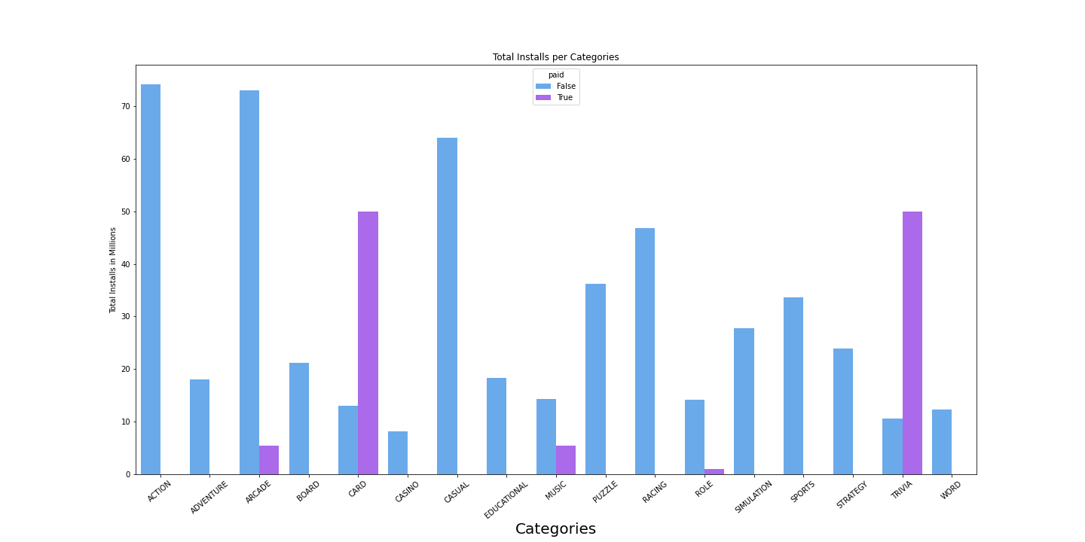
Average installs per category

Slide 11
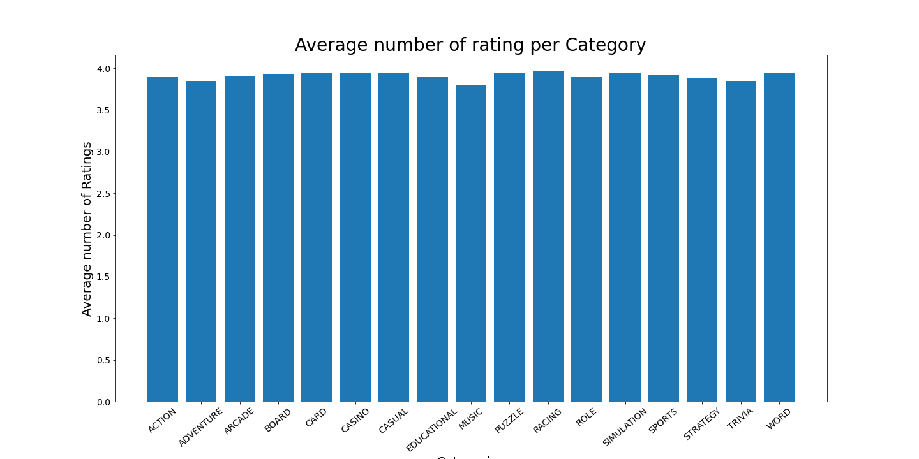
Categories and the average ratings
Notes:
It shows that there are no difference between the average ratings between the categories. So having a certain rating doesn’t correlate with popularity of a game.

Slide 12
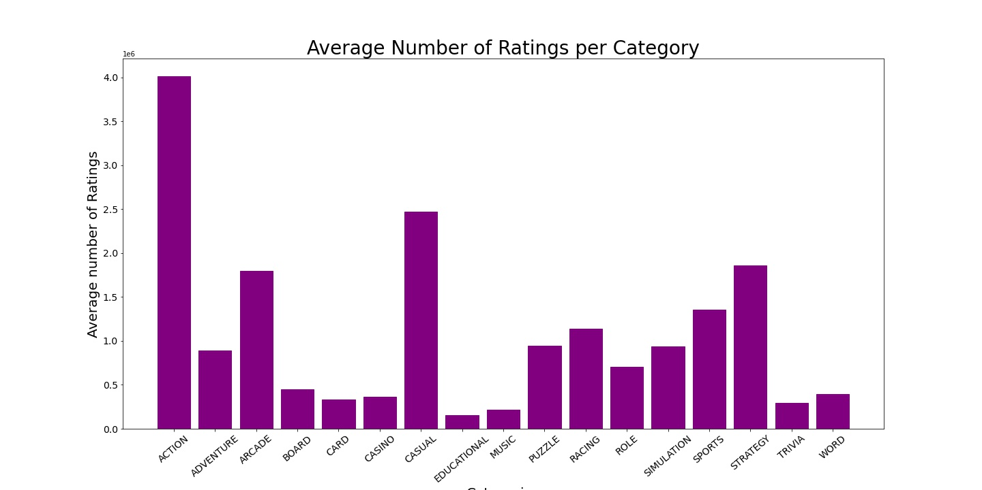
Category and average of sum Total Ratings
Notes:
This graph shows the number of ratings per category. I took the average of the ratings which gives us an idea of the number of ratings per categories. You can see that Action has the most ratings.

